Slide 1





Expense
Tracker
Archerd Alconaba
Allen Diaz
JV Reyes
Group 7 : Philtech Group 7

Slide 2

Project Idea
Expense Tracker is designed to help individuals monitor, categorize, and manage their spending to achieve better financial control and awareness.

Slide 3






Goals of Project
Provide a simple and User-friendly platform for tracking expenses.
Help people manage their own budget.
Empower users to effectively manage their finances.
Enable users to set and monitor budgets.
Analyze spending habits to promote better financial decisions.

Slide 4


User
Stories
As a user, we to Add daily expenses to track spending.
As a user, we to Categorize expenses for better insights.
As a user, we to View reports and charts to analyze spending.

Slide 5


Wireframes / Mockup
expense tracker visually outline its layout and functionality, showcasing features like transaction page, home page, overview page, categories page and Registration page for intuitive financial management.
Login Page
Overview Page
Transaction Page
Categories
Page
Registration Page
Profile
Page

Slide 6
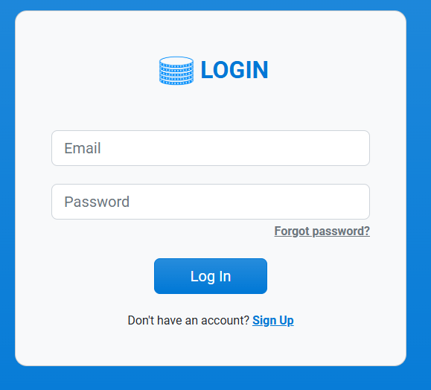
Wireframes / Mockup
Login Page

Slide 7
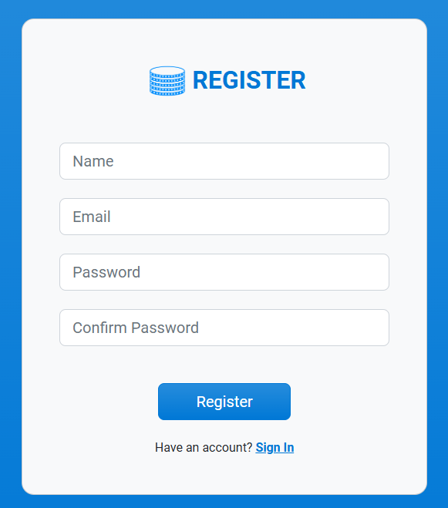
Wireframes / Mockup
Registration Page

Slide 8
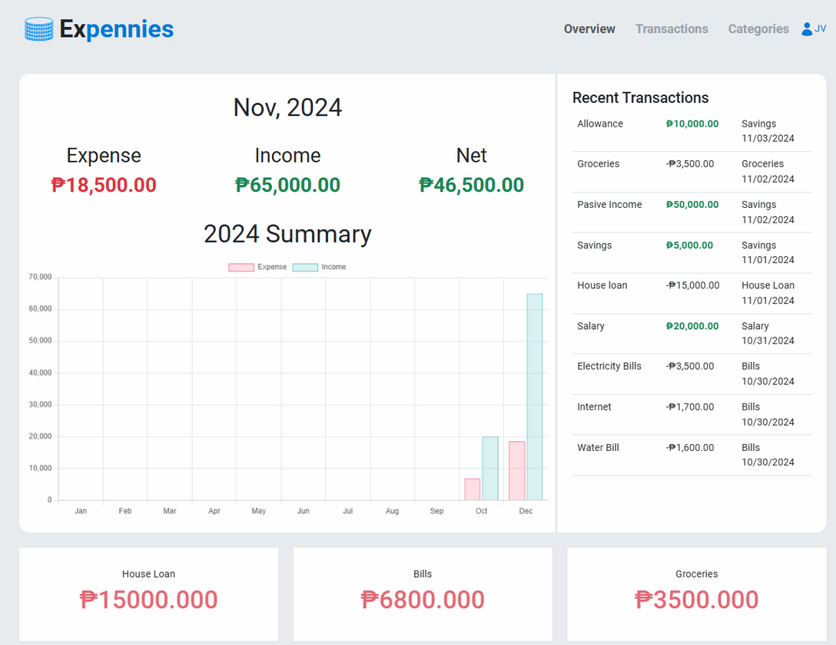
Wireframes / Mockup
Overview Page

Slide 9
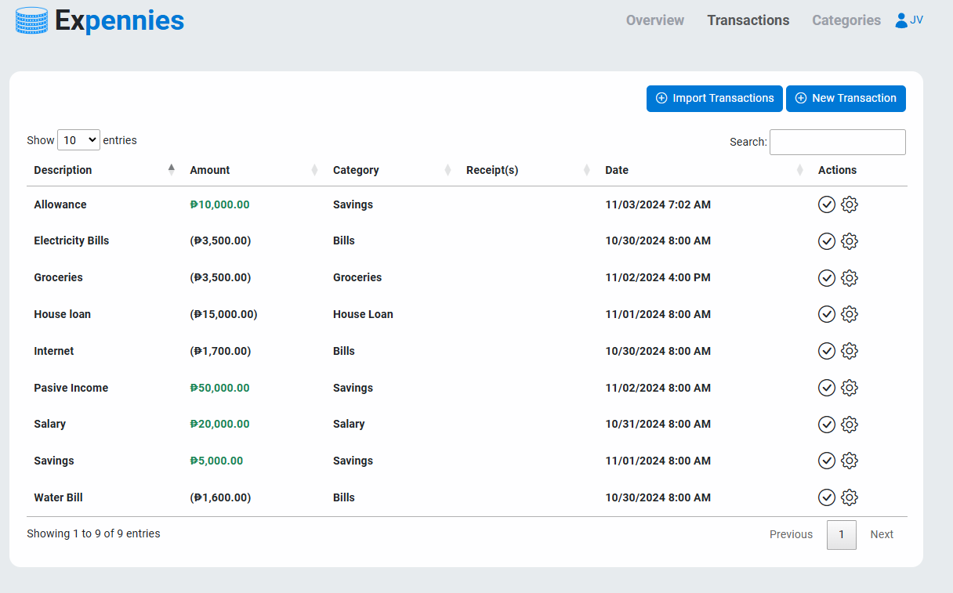
Wireframes / Mockup
Transaction Page

Slide 10
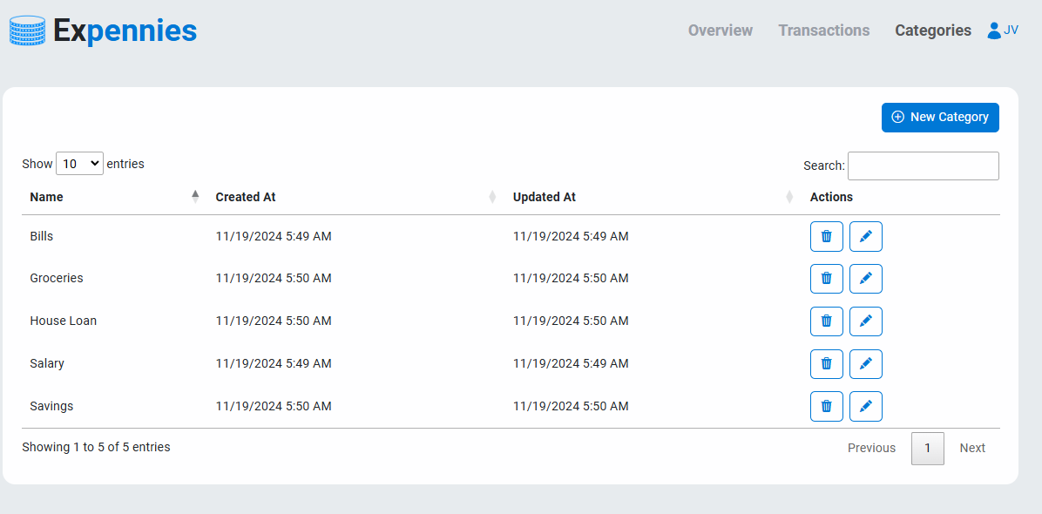
Wireframes / Mockup
Categories
Page

Slide 11
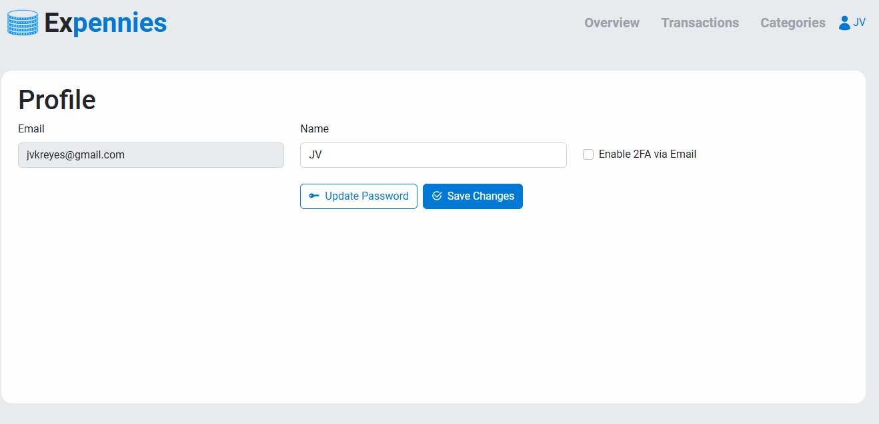
Wireframes / Mockup
Profile
Page

Slide 12
Tech Stack
PHP
Slim PHP
We used PHP for the backend to handle server-side logic, manage databases, and ensure secure and efficient processing of data in the expense tracker application.
We used Slim PHP with MVC for efficient backend processing and a responsive frontend in the expense tracker. easy to update the system.
PL/SQL
ChartJS
We used PL/SQL to manage and optimize database operations, ensuring secure and efficient data storage and retrieval for the expense tracker.
We used ChartJS for our AI analytics and JavaScript library for creating responsive, customizable charts, perfect for visualizing data in expense trackers and cloud applications.

Slide 13
Github Repository
https://github.com/Cherdman07/Expense-Tracker

Slide 14
Demo

Slide 15

Individual contributions
Archerd Alconaba - Frontend and Backend
- UI
Allen Diaz - Frontend and Backend
- UX
JV Reyes - Frontend and Backend
- Documentation

Slide 16

Thank You!
Questions and Answer

